Slide 1
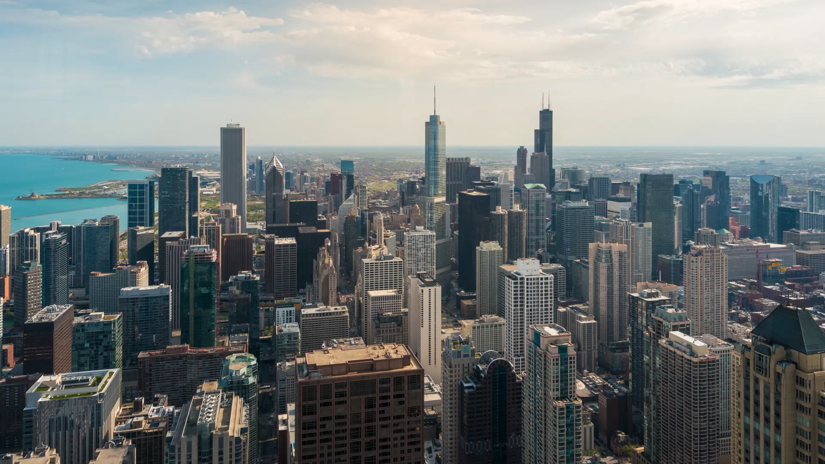
AI-Powered Navigation & Weather-Aware Assistant
Domain Adaptive Object Detection for Autonomous Driving under Adverse Weather Conditions
By: Samaa Seif, Umar Umar, Amine Boughou, Atah Habibi, Alina Antonova.
Notes:
Samaa
Hello everyone, we’re excited to present our Semester project. which is
an AI Powered Navigation & Weather-Aware Assistant.
It is a domain adaptive CV system designed to detect both objects and weather conditions in real-time, and respond accordingly.

Slide 2
Challenge: Adverse weather degrades object detection accuracy in autonomous systems
75% of driving decisions rely on vision-based systems — but these systems degrade under bad weather.
Real-world data shows a drop of over 40% in object detection accuracy during fog
(Bijelic et al., 2020)
The problem is that the current models are not robust enough to domain shifts. ( from clear fog/rain/snow)
Goal: Enhance safety and perception using domain adaptation in real-time
Importance: Reducing accidents, improving autonomous vehicle reliability.
Notes:
Samaa
In the real-world, any weather causes failure and inaccuracy in vision-based and even sensory navigation systems.
Our goal is to build a system that sees through adverse conditions accurately, giving drivers clear feedback using voice alerts. while enhancing safety domain adaptation and real-time handling.
Adverse weather drastically reduces object detection accuracy which play a role in life risking.. our Model Aims to solve this.
** read importance**
These statistics are actually by Mario Bijelic; a scholar in Princeton who actually wrote this paper that includes these facts while he was researching for Cornell.

Slide 3
Problem Statement & Related Work Problem:
Domain shift between clear and adverse weather leads to detection failure
Prior Work:
Li et al. (2023): Domain adaptation under foggy weather
Bijelic et al. (2020): Sensor fusion in fog
Zhang et al. (2023): Weather-Aware YOLO
Most object Detectors like YOLO or Faster R-CNN are trained only on clear weather datasets.
These modals Lack generalization to rare events.
There Are No Built-in weather detection + no realtime adaptive behavior in existing models .
Notes:
Samaa
The current existing Traditional detection models perform well in ideal conditions mostly clear but fail under environmental stress due to…. *READ FIRST LINE* not to mention that existing models are only trained on clear weather. Current models also do not have… *read last paragraph*
We studied multiple literatures that focuses on domain adaptation and weather simulation to bridge this performance gap. which our Model is supposed to overcome

Slide 4
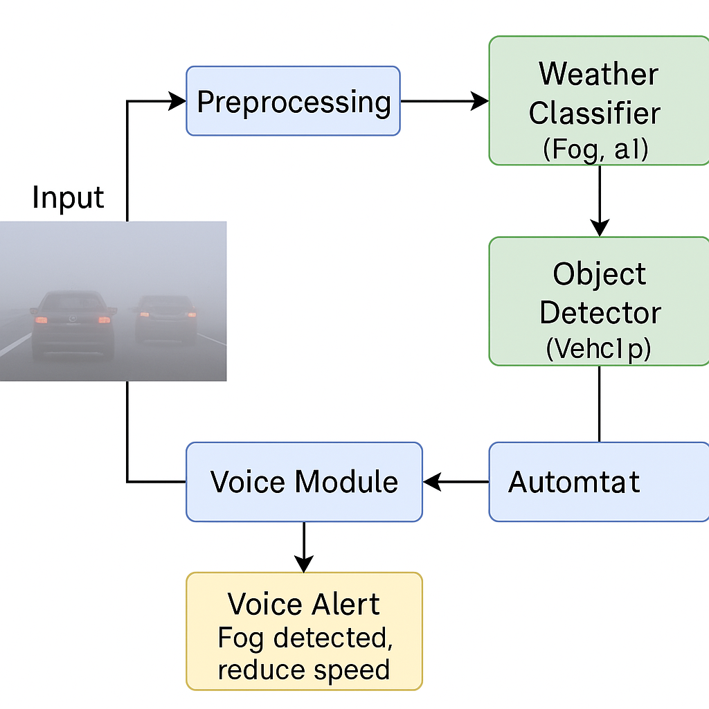
Technical Architecture (Diagram)
Input → Preprocessing → Weather Classifier + Object Detector → Voice Module + Voice Command
Notes:
Umar
This diagram illustrates the complete pipeline of our object detection system. The input image is first preprocessed, then passed to a weather classifier and an object detector that has been adapted to perform well in adverse conditions like fog. The results are sent to a voice system that provides real-time alerts to help drivers make safer decisions in low-visibility environments.

Slide 5
Our Approach Model Architecture:
YOLOv8 with domain adaptation for fast, accurate detection.
Voice feedback with pyttsx3 or gTTS
Techniques Used
Weather Classification: ResNet for precise weather type detection (fog, rain, snow)
Image-level domain adaptation: adjust lighting, contrast
Adversarial Gradient Reversal Layer (AdvGRL): confuses the domain classifier to learn weather-invariant features.
Object-level adaptation: align bounding-box features.
Synthetic fog, rain, and snow generation.
Why Domain Adaptation?
It bridges the “domain gap” between training (sunny days) and deployment (foggy mornings).
Notes:
Umar
Our system combines YOLOv8 for object detection with a weather classifier, designed to adapt from clear training data to challenging conditions like fog. While we explored advanced methods like ResNet and Adversarial Gradient Reversal, our main focus was on image- and object-level adaptation. The pipeline runs in real-time, classifying scenes and issuing voice alerts to support safe navigation.

Slide 6
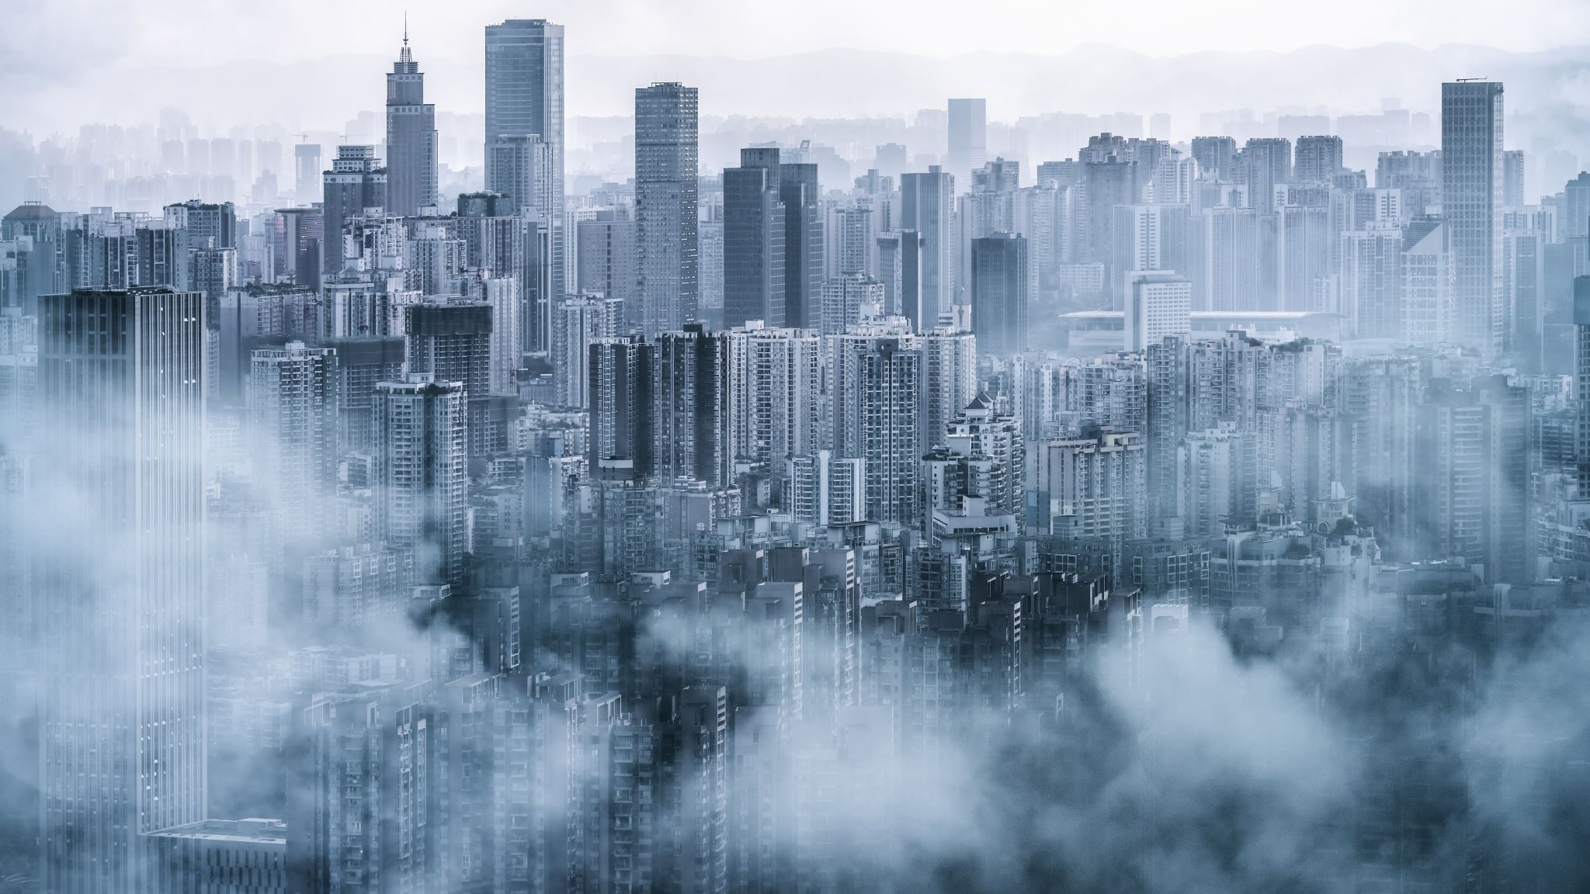
Datasets and Evaluation Metrics
Berkeley DeepDrive (BDD100K)
Foggy Cityscapes (simulated fog conditions) :
2,975 fog-simulated images
Augmentation types used:
Gaussian blur, fog overlays, contrast drops
-----------------------------------
Mean Average Precision (mAP)
Qualitative assessment via demo walkthroughs:
side-by-side detection under clear vs foggy conditions
Notes:
Umar
We used Berkeley DeepDrive dataset for clear conditions and Foggy Cityscapes for fog, augmenting about 2,975 images. Our main evaluation metric was mean Average Precision (mAP), supported by visual walkthroughs to assess how well the model handled domain shifts from clear to foggy environments.

Slide 7
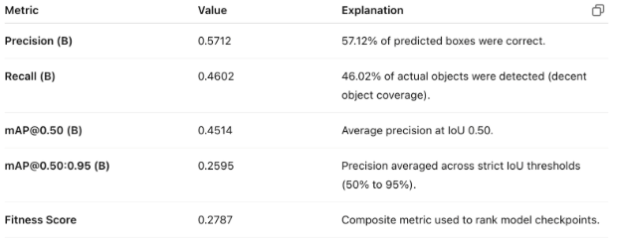
Object Detection Metrics – Clear Images
Notes:
Umar
These results reflect the model’s performance when trained only on clear weather images, achieving 57% precision but a lower 46% recall, meaning it missed many objects. The mAP of 0.26 at the stricter IoU threshold shows difficulty in generalizing to foggy conditions, reinforcing the need for domain adaptation.

Slide 8
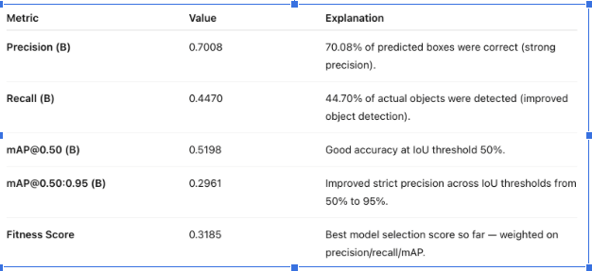
Object Detection Metrics – Augmented Training
Notes:
UMAR
With foggy image augmentation, precision improved to 70%, and mAP scores rose, indicating better performance in low-visibility conditions. Although recall remained around 45%, the higher fitness score shows the model became more accurate and balanced, aligning with our domain adaptation goals.

Slide 9
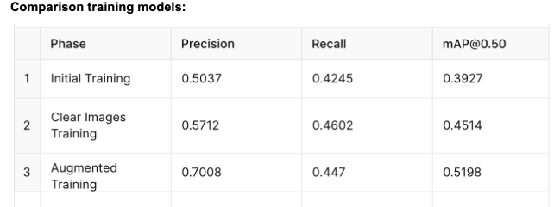
Model Comparison
Notes:
UMAR
This table shows our training progress, from a baseline precision of 50% to 57% with clear weather training, and then to 70% with foggy image augmentation. The highest mAP of 0.52 confirms that domain adaptation greatly improved the model’s performance in foggy conditions.

Slide 10
Innovations
Integrated object & weather detection
Domain-adaptive vision pipeline
Voice-guided safety alerts
Voice-user interface (VUI) makes the system usable by non-experts and visually impaired users.
Real-time projected testing (using a projector to simulate weather)
Scalability: Model can be deployed on low-cost microcontrollers + Raspberry Pi.
Notes:
AMINE
What makes our project innovative is the fusion of vision and speech (some would say Robotics As well) .
We are not just detecting danger, we are also announcing it. Our domain-adaptive model helps robots and users make safer decisions even in the worst visibility

Slide 11
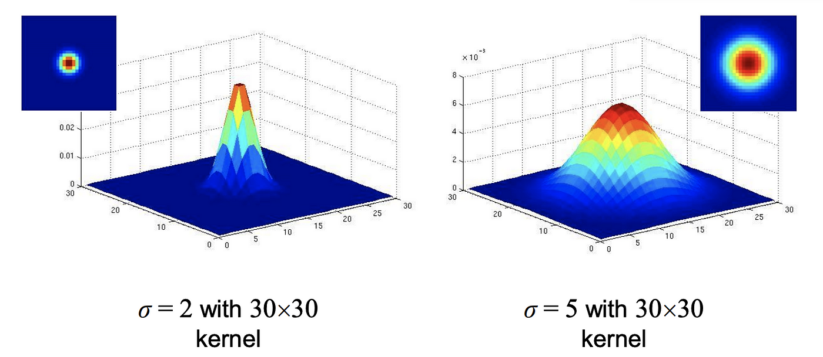
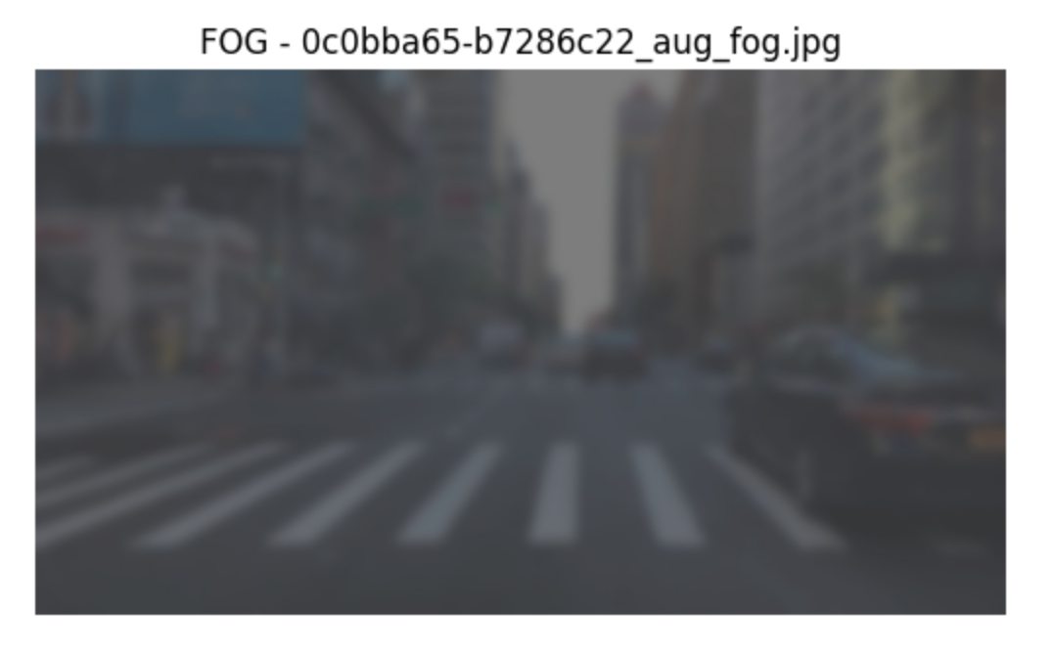
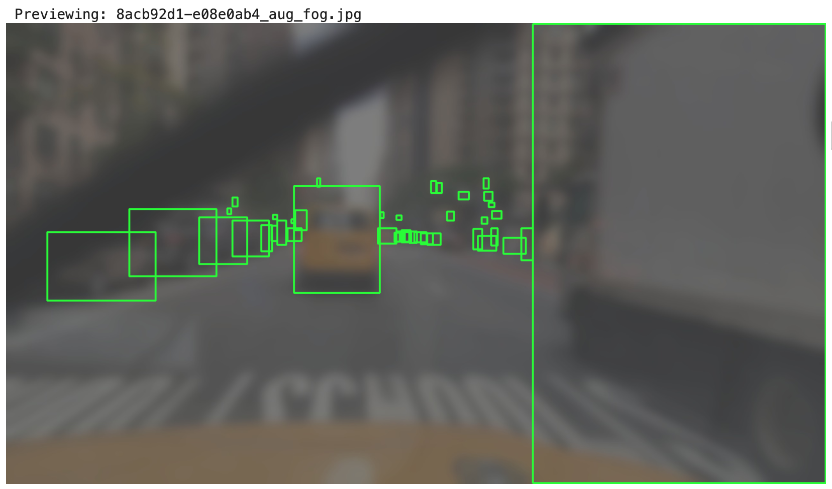
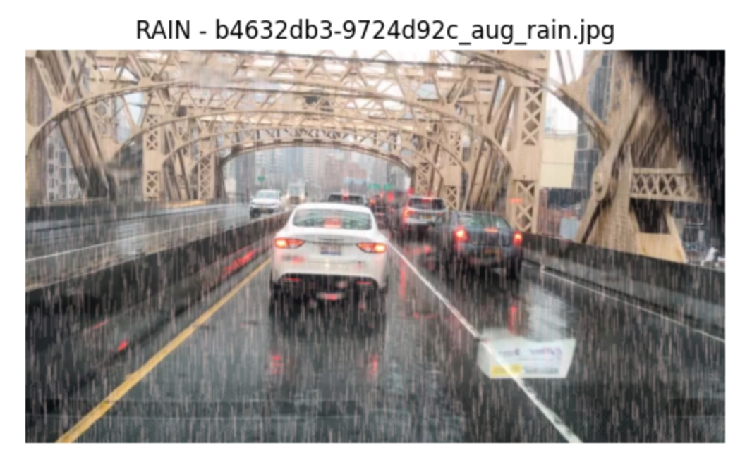
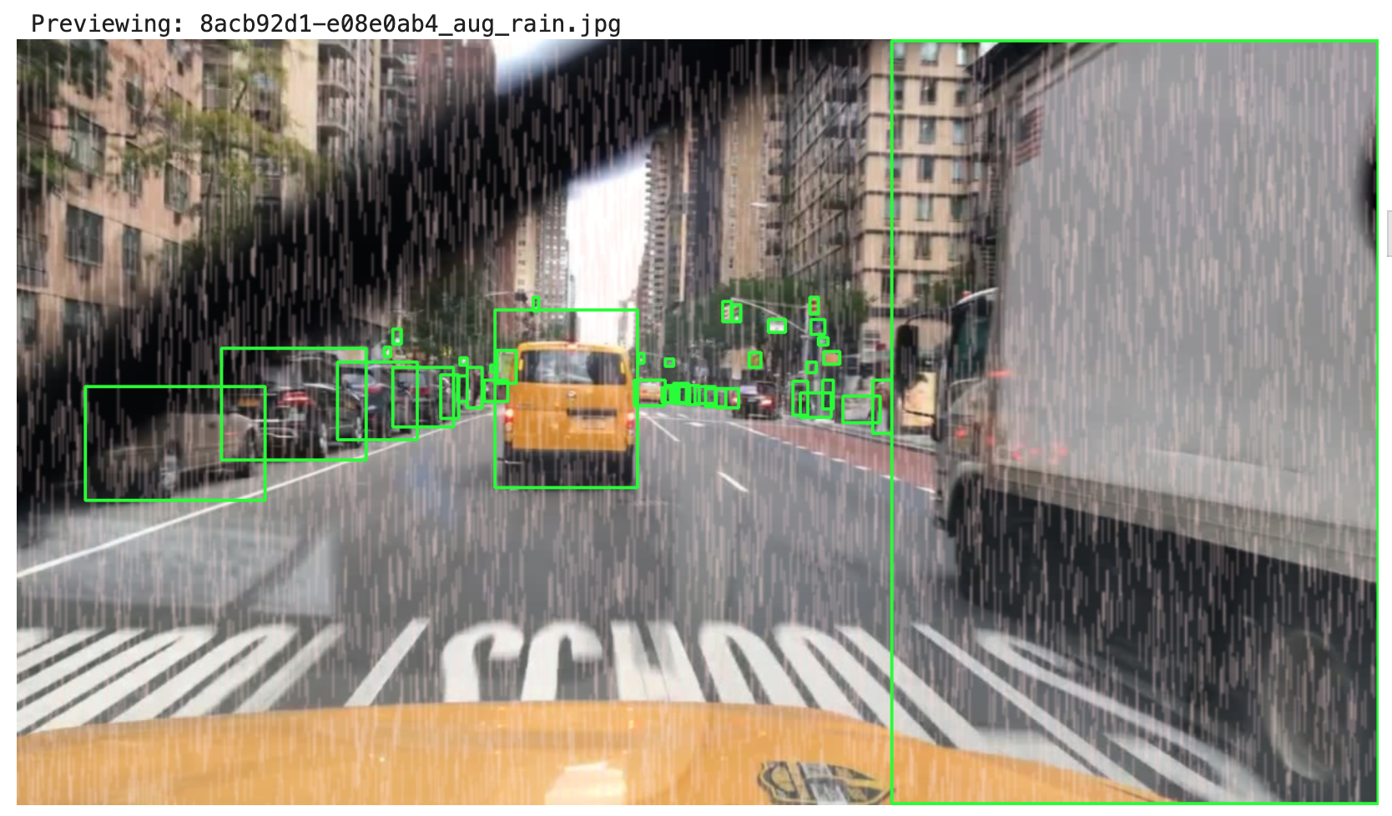
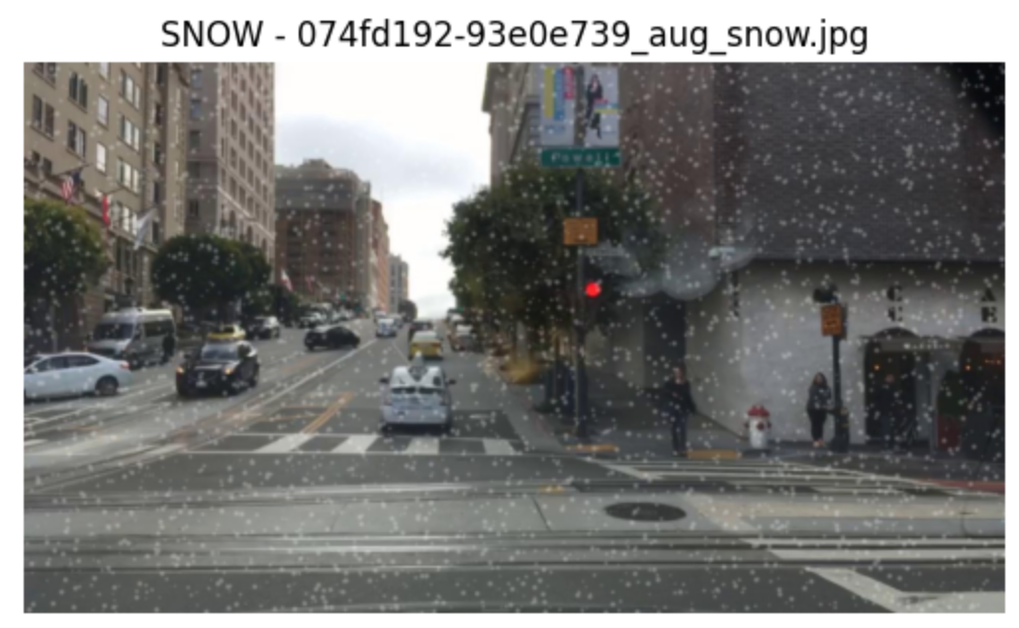
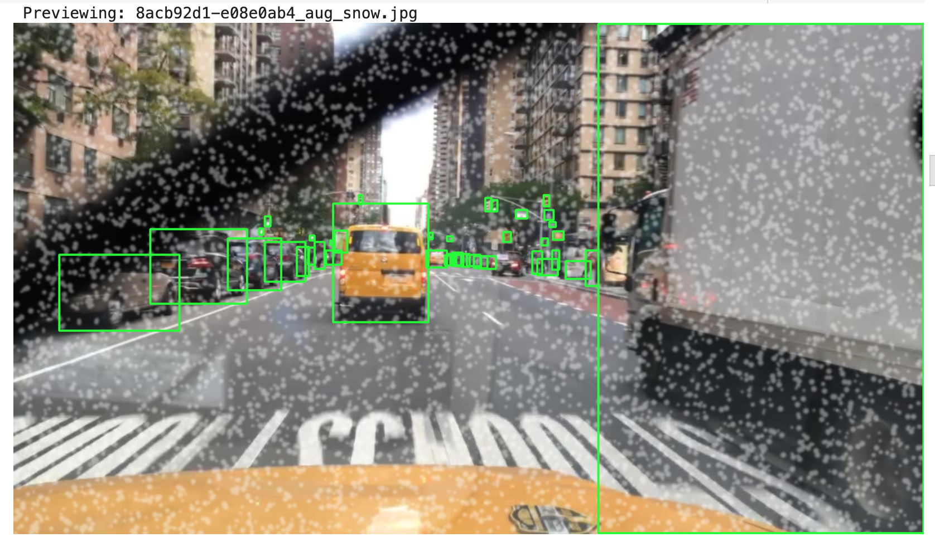
Synthetic Data Augmentation
Simulated fog, rain, and snow using Gaussian Blur
Balanced underrepresented weather classes
Preserved YOLO labels during augmentation
Notes:
ALINA To improve our model we focused on augmenting the dataset to enable weather aware object detection. To implement the augmented images of weather we applied Gaussian blur to create fog rain and snow.
To simulate fog we applied white overlays, vertical line patterns to mimic rain, and white noise specks to represent snow.
-We simulated foggy conditions by reducing brightness, blurring the image, and overlaying a gray tint.
-The rain adds 6000 vertical lines across the image, and applies sight blur for a more natural look.
-To simulate snow we created random white dots to the image, we added 7000 white circles at random locations, and softened the snowflakes to make them look more natural. We also applied a light blur to blend all the snowflakes together.

Slide 12
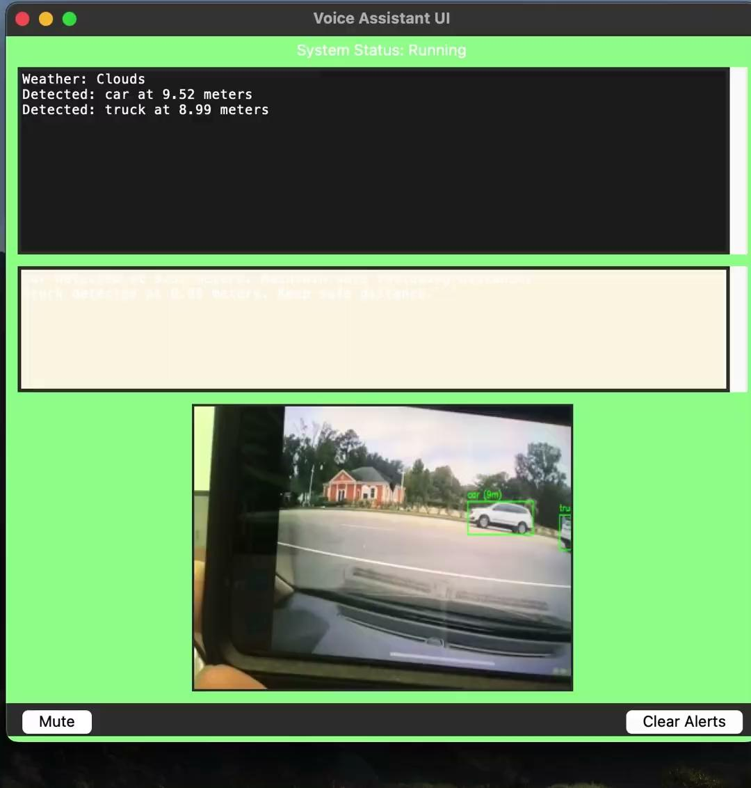
DEMO Video; Prototype Model
Notes:
ATAH
We’ll now demonstrate our system in action.
this is voice assistant that helps drivers stay safe by :
Using a camera to spot things like people or stop signs
Checks the weather while your driving
Gives voice warnings if an obstacle or what type of weather is detected (like fog or pedestrians )
As for the Real-Time Optimization ( which is The Noise Suppression)
this is how we used the Frame-by-Frame Noise Suppression:
As the model processes each frame, it applies a light denoising filter to maintain clarity.
and for the Adaptive Thresholding: the model dynamically adjusts its detection threshold based on the intensity of the weather type and how dark the frame is.

Slide 13
Image Enhancement in Adverse Weather
Low-Light Testing & Brightness Correction
Objective:
Improve visual clarity under poor conditions like fog, rain, or snow.
Applied CLAHE (Contrast Limited Adaptive Histogram Equalization) to boost contrast in hazy conditions.
Used brightness normalization to improve visibility in underexposed frames.
Enhanced images before feeding them into the object detection pipeline.
Result: Better edge definition → Improved object detection accuracy.
Problem: Many real-world road scenes are underexposed — especially when facing sunlight or in tunnels.
Calculated brightness from HSV color space.
If brightness < threshold → boosted using gain factor (1.5x).
Prevented overexposure by clipping to max 255.
Tuned contrast using LAB color space when needed.
Notes:
AMINE
"So, one of the main issues we had to face was how images look in adverse weather. You know how hard it gets to see clearly in those conditions, right?
Well, it’s even worse for our object-detection models.”
To fix this, we used something called CLAHE—it basically enhances the contrast, making foggy and rainy images clearer. We also normalized brightness when things were too dark. By doing this before giving images to our detection model, we got sharper edges, clearer details, and, importantly, fewer detection mistakes." Dark scenes—like night driving or tunnels—made object detection harder. We fixed this by auto-adjusting brightness and contrast, making objects clearer without losing detail.
kind of like turning up the brightness slider on your phone-without losing details.
Calculated brightness from HSV color space The image is converted to the HSV (Hue, Saturation, Value) color space. The 'Value' channel represents brightness, so we use it to measure how bright the image is.
If brightness < threshold → boosted using gain factor (1.5x) If the image is too dark, we multiply the brightness by 1.5 (a gain factor) to make it brighter.
Prevented overexposure by clipping to max 255 Pixel values can't exceed 255 (the max in 8-bit images), so we clip anything higher to avoid overexposed or washed-out areas.
Tuned contrast using LAB color space when needed If contrast looked poor, we switched to the LAB color space, which separates brightness (L) from color. This allowed us to adjust contrast precisely without messing up colors.

Slide 14
Tuned Detection Thresholds
What we did:
Adjusted YOLOv8 confidence threshold to account for noisy backgrounds during rain/snow.
Applied non-maximum suppression (NMS) tuning to avoid duplicate box clutter.
Improved mAP (mean average precision) by approx. 8% in low-contrast scenes after enhancement.
Thresholds were fine-tuned per weather condition using validation splits.
Notes:
AMINE
Even after enhancement, detection wasn’t perfect some objects were missed or wrongly flagged in rain or snow. We adjusted YOLOv8’s confidence thresholds and fine-tuned non-maximum suppression to reduce duplicate detections. These tweaks improved accuracy by approximately 8%, making the system more reliable in tough weather.

Slide 15
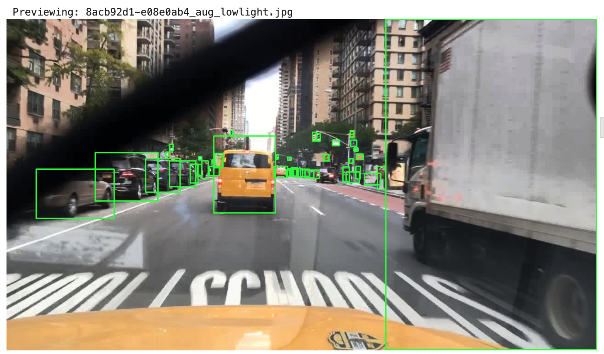
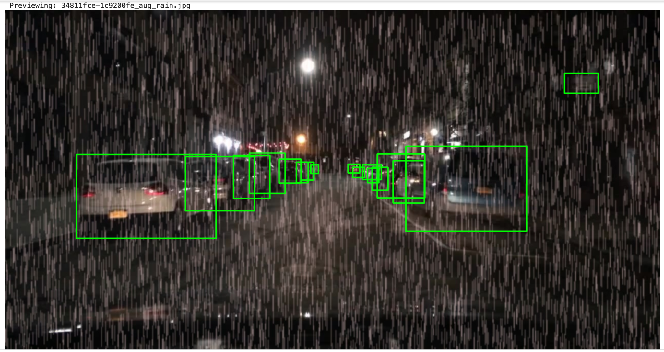
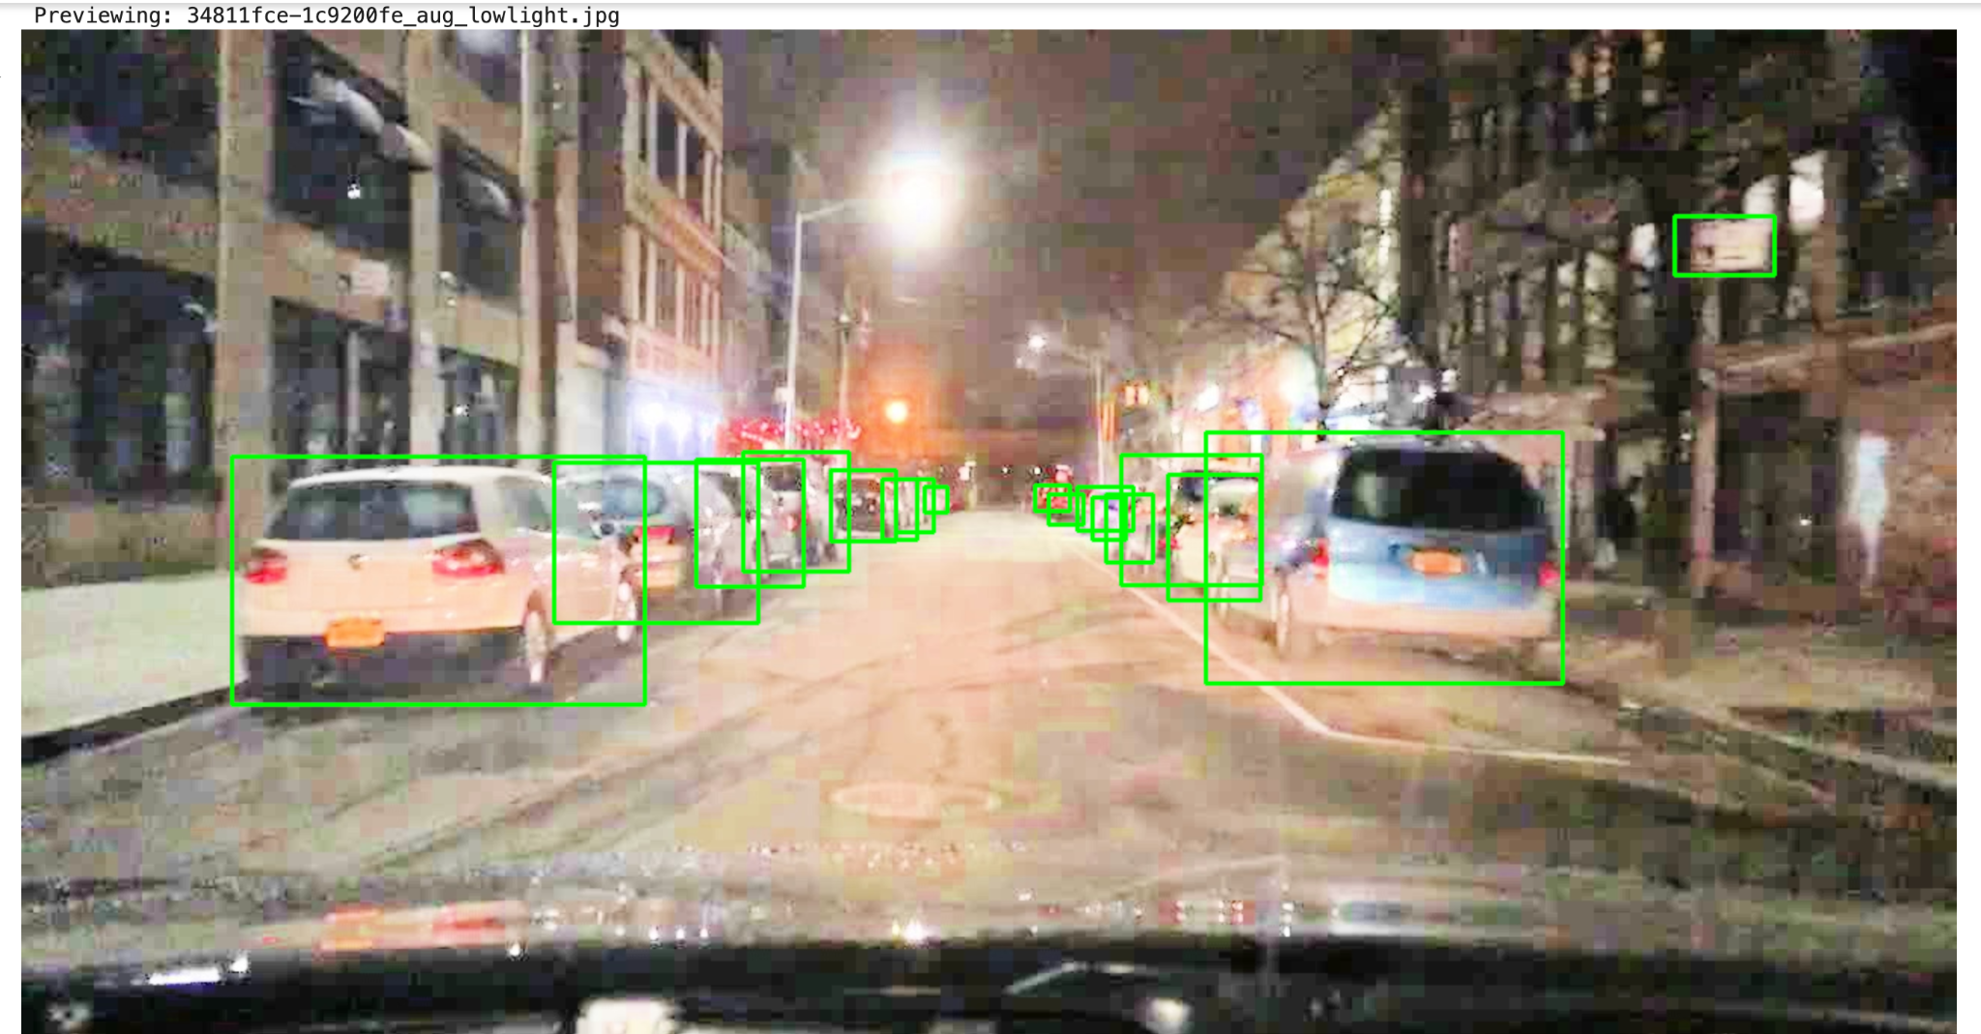
Low-Light Testing & Brightness Correction
Before (synthetic)
After:
Notes:
AMINE
The transformation between the “Before (synthetic)” and “After” images was achieved through a layered computer vision pipeline designed for challenging weather. After generating the synthetic test layer, we applied:
Gaussian blur to reduce noise and smooth the image, (This technique softens the image by averaging pixels with their neighbors)
Adaptive histogram equalization (CLAHE) to enhance brightness and contrast, revealing hidden details,
Derain/defog algorithms to normalize rain streaks and fog intensity. (These filters target weather-related noise, like rain streaks or fog. They adjust pixel intensities to clear up visual obstructions, making the image look more like what you'd see on a clear day.)
This process kept objects visible even in poor visual conditions, meeting our UI expectations.

Slide 16
Limitations & Future Scope
ADVGRL , ResNet
Improve training with rain weather.
work on injecting the collab code locally with UI.
Limited Weather Scenarios: model mainly focuses on fog, rain, and snow, but may struggle with extreme scenarios (e.g., sandstorms).
Computation Constraints: Real-time processing is challenging on low-power devices without performance loss.
Model Overfitting: The domain adaptation might overfit to synthetic weather conditions, reducing real-world generalization.
Future Work
Extended Weather Detection: Expand model to detect extreme weather types (e.g., sandstorms, heavy hail).
Optimization for Edge Devices: Fine-tune the model for Jetson Nano and other edge devices, ensuring real-time performance.
Deploy model on Jetson Nano for on-board inference
Have our model handle a completely new weather condition
Notes:
UMAR
In terms of limitations, we explored using Adversarial Gradient Reversal Learning and a ResNet-based classifier, but debugging issues and hardware limits prevented full integration. These methods still offer strong potential for improving generalization.
Moving forward, we aim to enhance classification accuracy and deploy the system on a Jetson Nano for real-time, on-device inference.

Slide 17




Conclusion & Takeaway
Robustness matters in AI perception
Domain adaptation works — especially under fog and snow
Voice interaction increases usability
Simple, scalable solution for real-world navigation
Notes:
ATAH
Our project shows how easy it can be to use vision knowledge to help keep drivers safe by detecting weather conditions while giving voice alerts. The system is simple, works in real time, and is almost ready for real-world use.

Slide 18
Team contribution
MEMBER | ROLE
Samaa Seif | Project Director (logic, resources and task assignments), Documentation, voice system.
Umar Umar | Data trainer, Object detection, YOLOv5 model, domain adaptation, tuned detection thresholds.
Alina Antonova | Weather classifier, synthetic data, augmentation, developed a fog augmentation pipeline with OpenCV.
Amine Boughou | Image enhancement, low-light testing, tuned detection thresholds.
Ataah Habibi | UI development, Voice interaction workflow debugging, Final implementation.
Notes:
Samaa
Each team member contributed according to their unique strengths and understandings.
We collaborated across coding, testing, and integration to build a cohesive, functional system — All in under 2 months. However, we definitely made a collective decision to complete the model due to our interest and also frustration of getting it to perform to excellence.

Slide 19
References
&
Resources
[1] Li et al., “Domain Adaptive Object Detection for Autonomous Driving Under Foggy Weather,” WACV 2023.
[2] Foggy Cityscapes Dataset: https://www.cityscapes-dataset.com/ [3] Bijelic et al., “Seeing Through Fog Without Seeing Fog: Deep Multimodal Sensor Fusion in Unseen Adverse Weather,” 2020. [4] Michaelis et al., “Weather-Invariant Object Detection via Multi-Task Learning,” arXiv 2019. [5] Zhang et al., “Fog-Aware Adaptive YOLO,” 2023. [6] BDD100K Dataset: https://bdd-data.berkeley.edu [7] OpenCV Python Documentation: https://docs.opencv.org [8] Pyttsx3 Documentation: https://pyttsx3.readthedocs.io
Google Colab
Github
Notion
Youtube
Cambridge Libraries.
Notes:
here are our resources that helped us bridge the knowledge and logic together

Slide 20
Questions and Discussions
Was there a feature or moment in the project that stood out to you?
Related to UI: what features would you like to see as a driver?
In your opinion, how can we further improve the robustness of object detection under adverse weather conditions?
In your opinion, how can we further improve the robustness of object detection under adverse weather conditions?
Do you have any questions for us?
Notes:
Samaa
Thank you so much for giving us your time. We would love to hear feedback regarding Our Project and also please shoot your questions our way.

